Slide 1
A PROJECT ON :-
HOSPITAL MANAGEMENT SYSTEM

Slide 2
Content Layout
Introduction
Purpose
Project Features
Hardware and Software Requirements
Flow Chart
ER Diagram
Testing
Conclusion

Slide 3
1. Introduction
Hospital Management System is a process of implementing all the activities of the hospital in a computerized automated way to fasten the performance. This includes doctors , patients and specialists . This project provides excellent security of data at the entry level of user-system The project Hospital Management system includes registration of patients, storing their details into the system, and also computerized in the pharmacy, and labs. The software has the facility to give a unique id for every patient and stores the details of every patient and the staff . It includes a search facility to know the current status of each room. Users can search the details of a patient using the id. The Hospital Management System can be entered using a username and password. It is accessible either by an administrator or receptionist. Only they can add data into the database. The data can be retrieved easily. The interface is very user-friendly. The data are well protected for personal use and make the data processing very fast.
Hospital Management System is powerful, flexible, and easy to use . Hospital Management System is designed for multispeciality hospitals, to cover a wide range of hospital administration and management processes. It is an integrated end-to-end Hospital Management System that provides relevant information across the hospital to support effective decision-making for patient care, hospital administration, . Hospital Management System is a software product suite designed to improve the quality and management of hospital management . Hospital Management System enables you to develop your organization and improve its effectiveness and quality of work. Managing the key processes efficiently is critical to the success of the hospital helps you manage your processes.

Slide 4
2.Purpose
The main objective of the Project on Hospital Management System is to manage the details of Hospital, Doctors, Patient, Employee, Test. It manages all the information about Hospital, Medicine, Test, Hospital. The project is totally built at administrative end and thus only the administrator is guaranteed the access. The purpose of the project is to build an application program to reduce the manual work for managing the Hospital, Doctors, Medicine, Patient. It tracks all the details about the Patient, Employee, Test

Slide 5
Project Features
• The system automates the manual procedure of managing hospital activities.
• Doctors can view their patients’ treatment records and details easily.
• The system is convenient and flexible to be used.
• It saves their time, efforts, money, and resources .

Slide 6
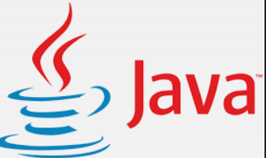
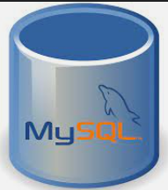
Hardware And Software Requirement
1 . NETBEANS
NetBeans-14 is an integrated development environment for Java. NetBeans allows applications to be developed from a set of modular software components called modules. NetBeans runs on Windows, macOS & Linux. In this project we are using NetBeans 14 IDE for designing, creating & debugging. We have used Java swing for creating a user friendly and user interactable graphical user interface.
2. JDK 18(Java Development Kit)
JDK (Java Development Kit) is a development environment for building applications, applets, and components using the Java programming language. The JDK includes useful tools such as Java Runtime Environment (JRE), an interpreter (java), a compiler (javac), an archiver (jar), a documentation generator(Javadoc), and some other development tools for developing and testing programs written in the Java programming language and running on the Java platform. In this project JDK version 18.0.2 is used for compiling and running the program.
3. MySQL
To store, organize & manipulate data, a database is required. For this purpose, we are using MySQL.
MySQL is an open-source relational database management system (RDBMS). To link the database with
the program, JDBC api & java. SQL package is used.

Slide 7
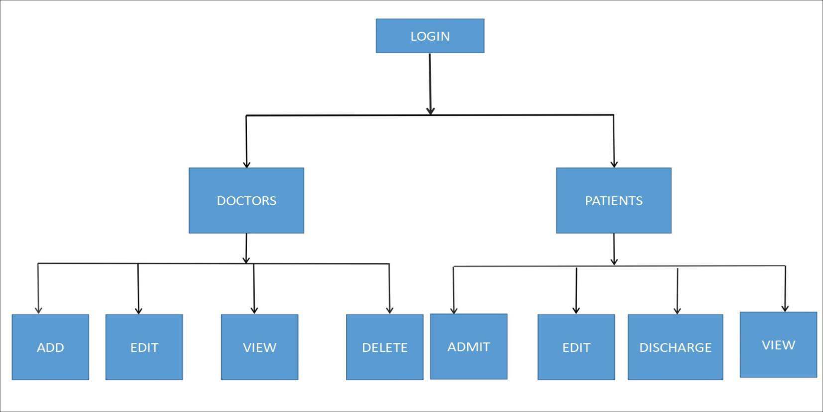
Flowchart
A flow chart is a visual diagram that shows the steps of any process from beginning to end, using process boxes, flow lines/arrows and other symbols.

Slide 8
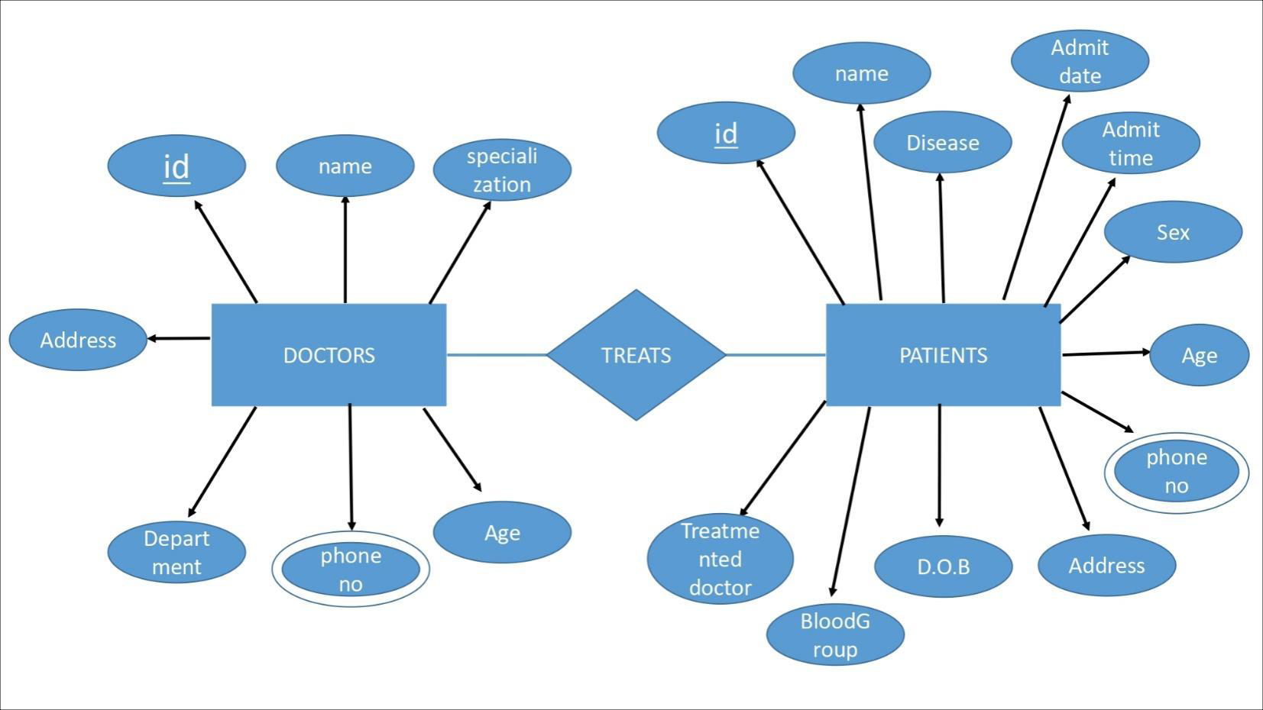
ER Diagram

Slide 9
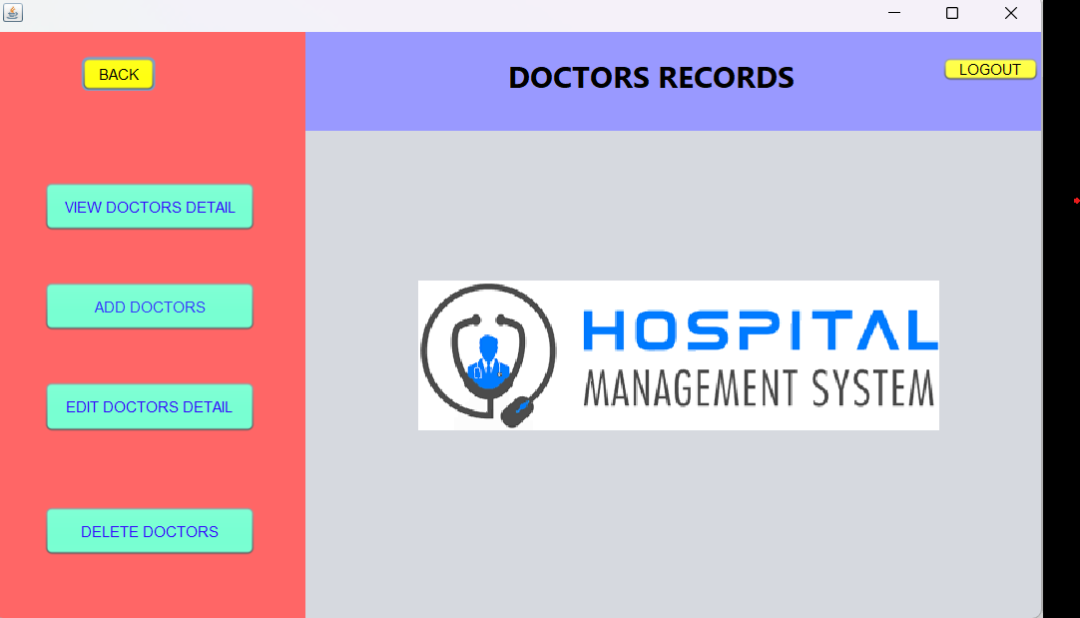
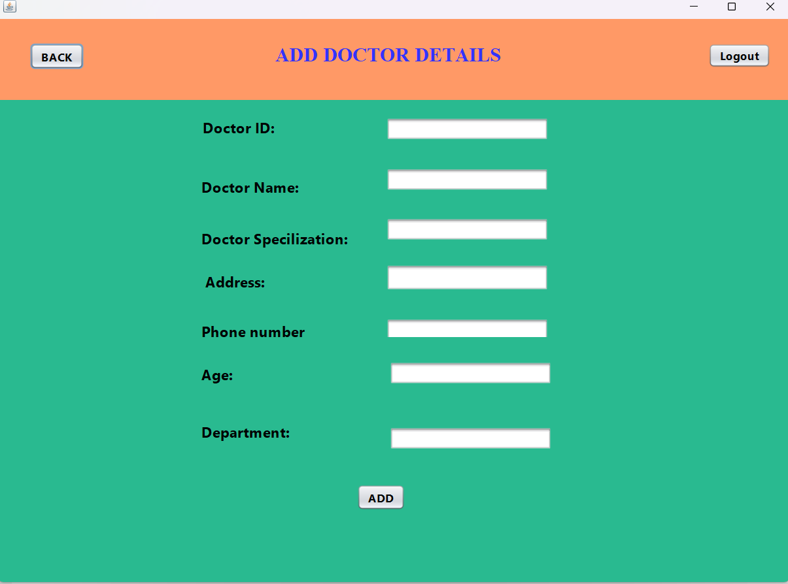
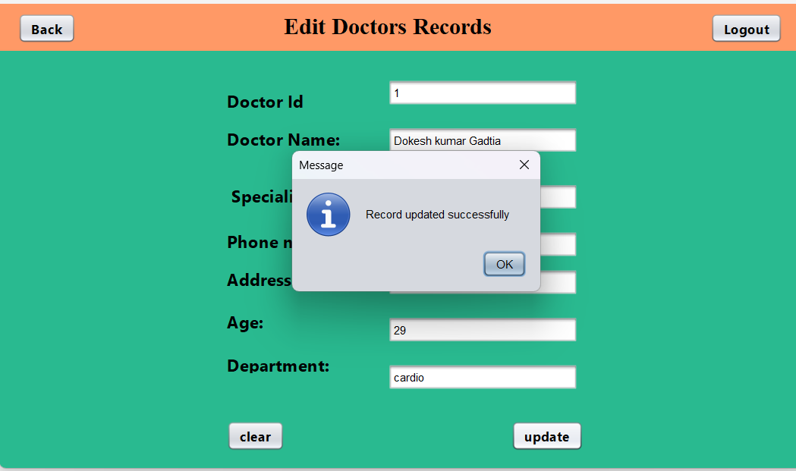
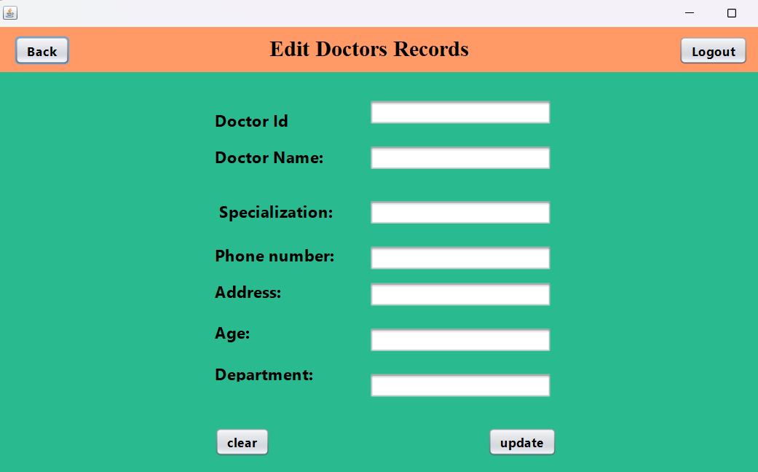
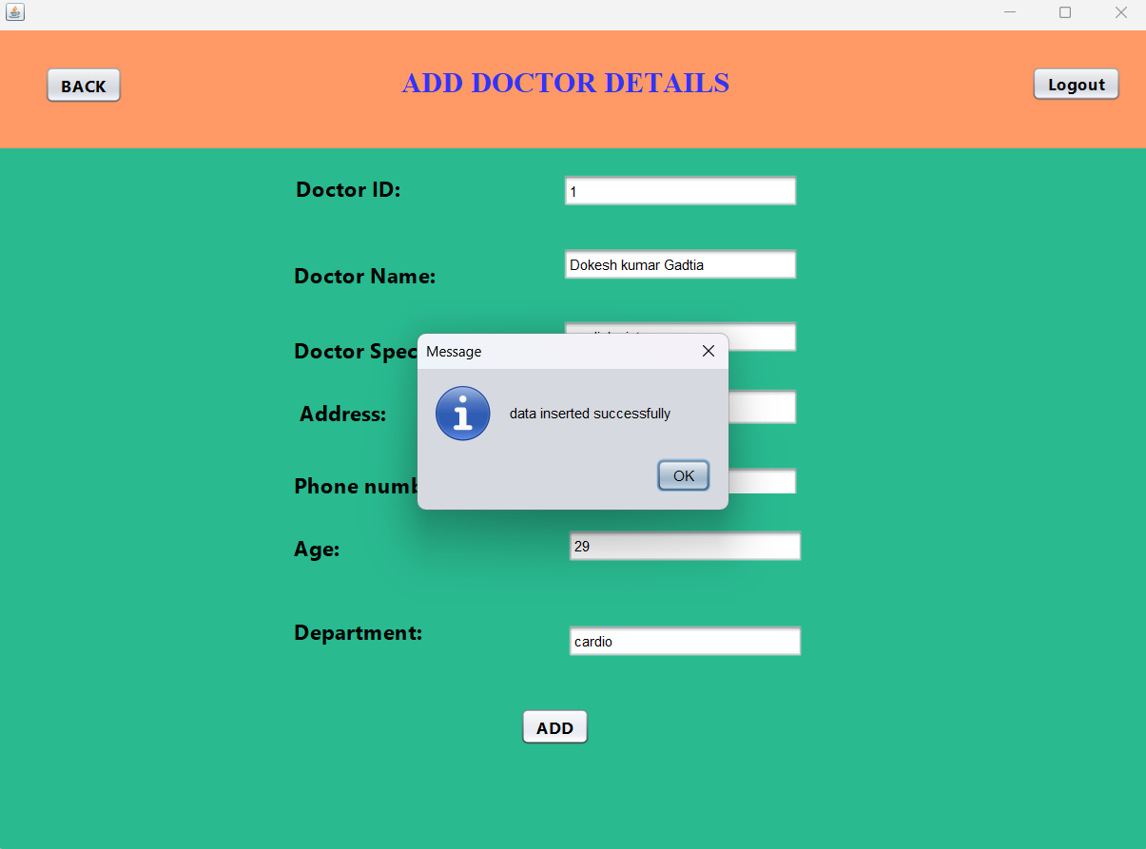
Testing
DOCTORS RECORS TEST
INPUTS
OUTPUTS

Slide 10
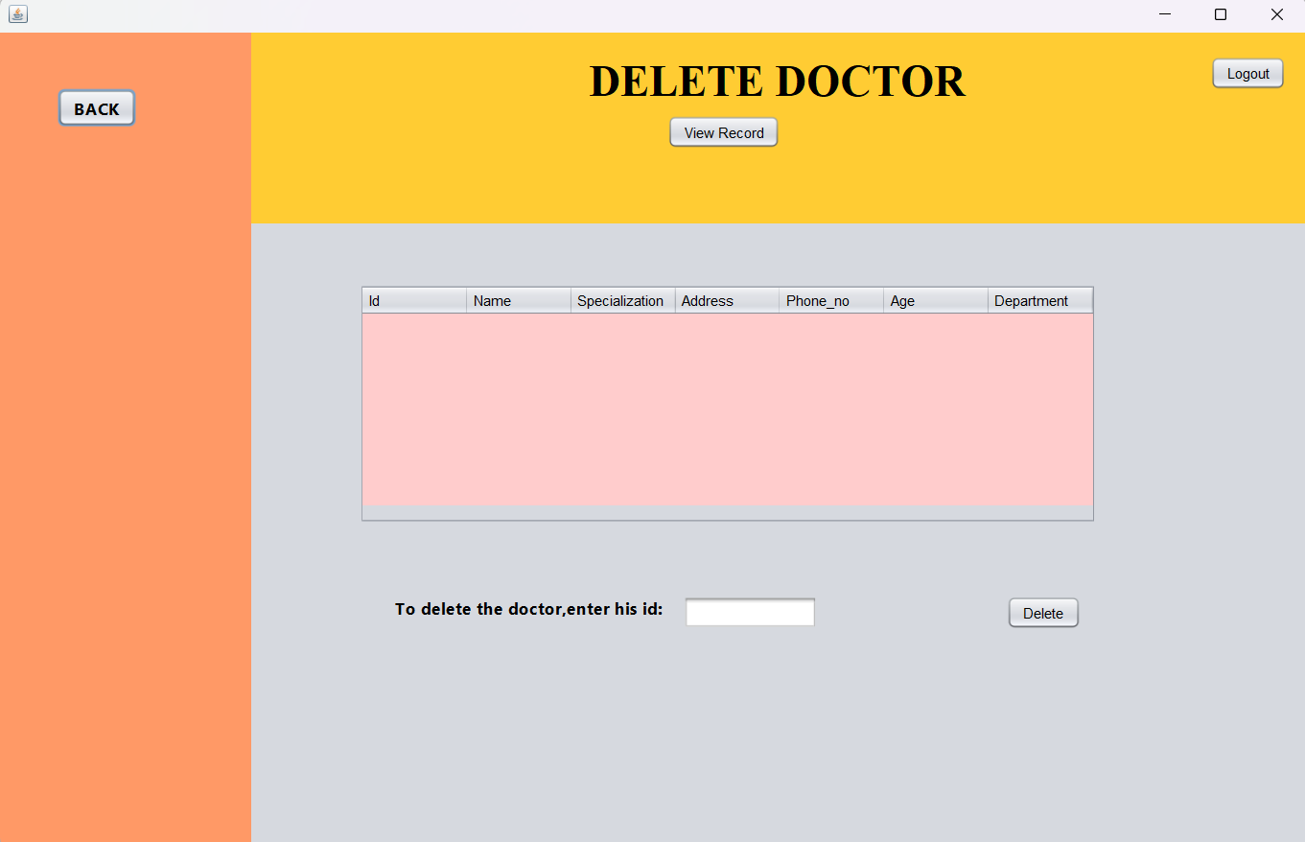
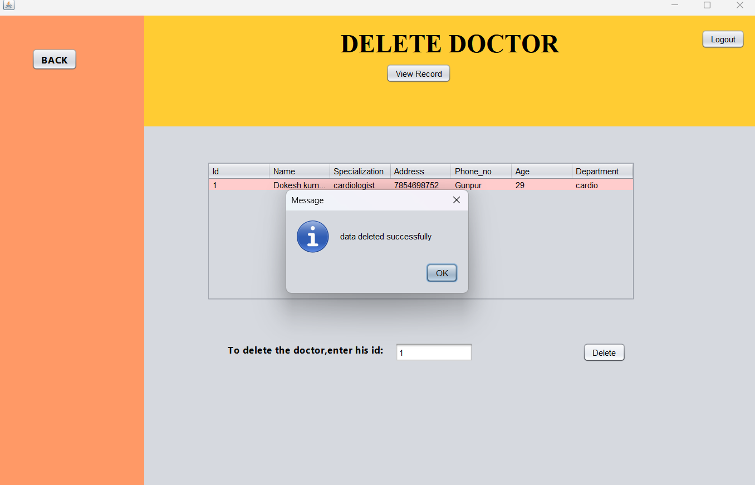
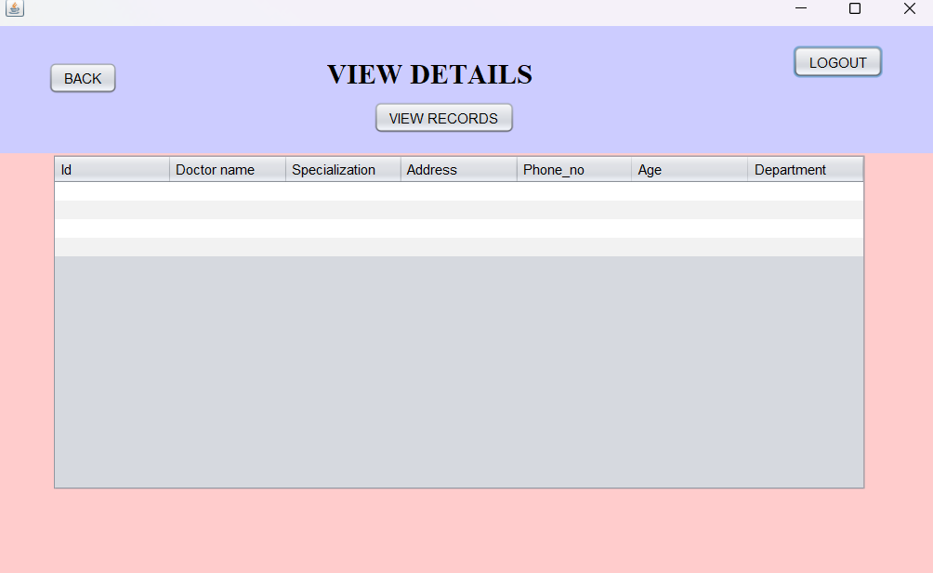
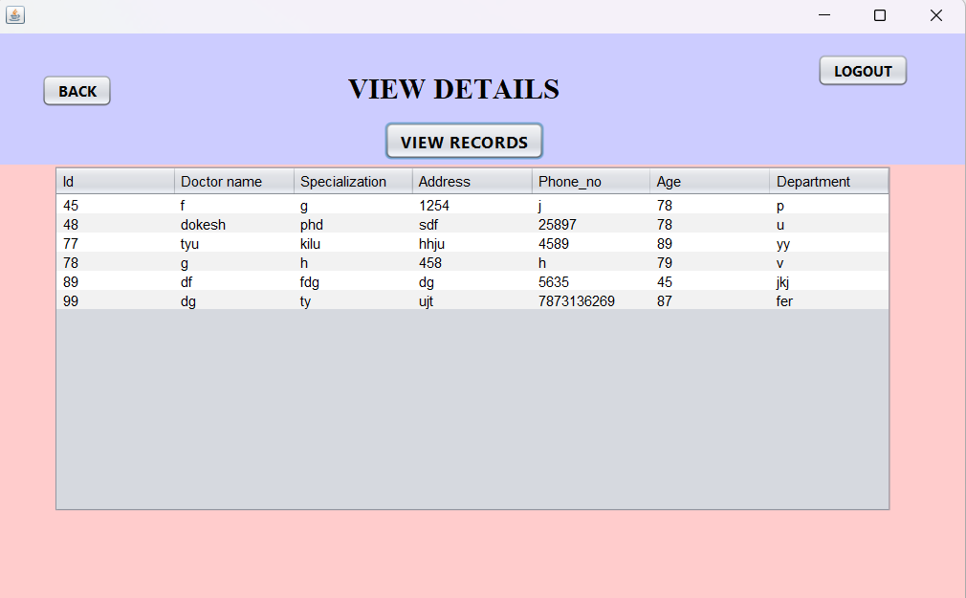
DOCTORS RECORS TEST
INPUTS
OUTPUTS

Slide 11
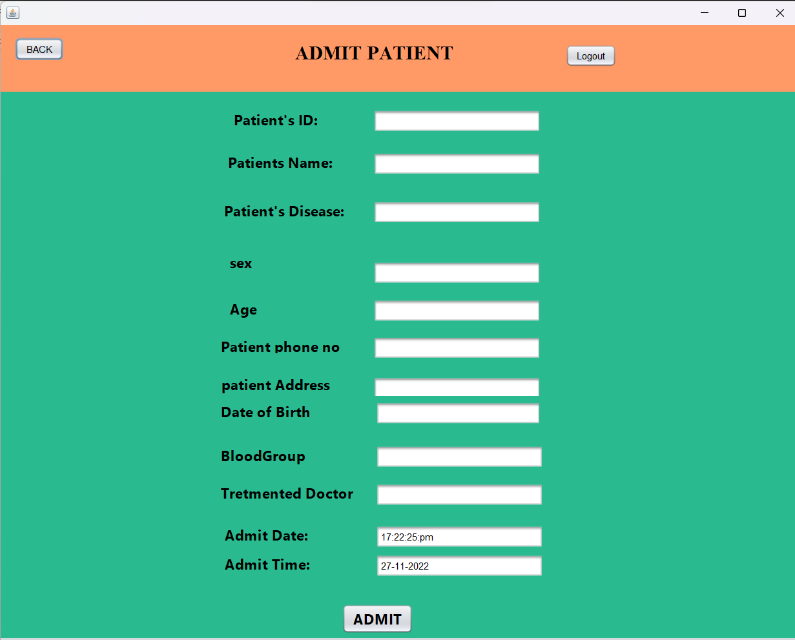
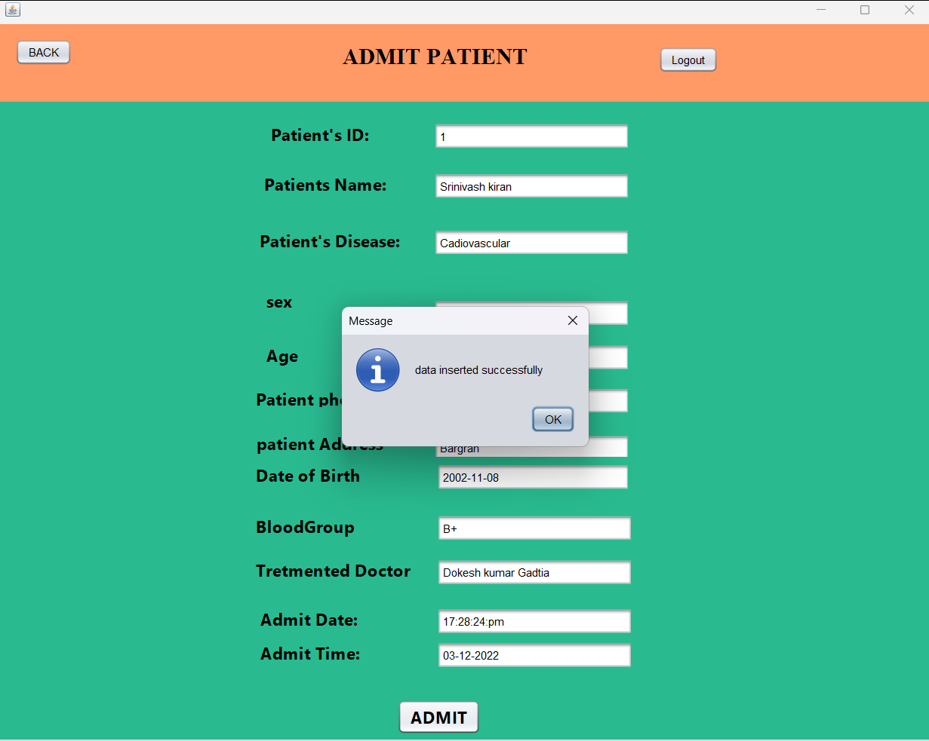
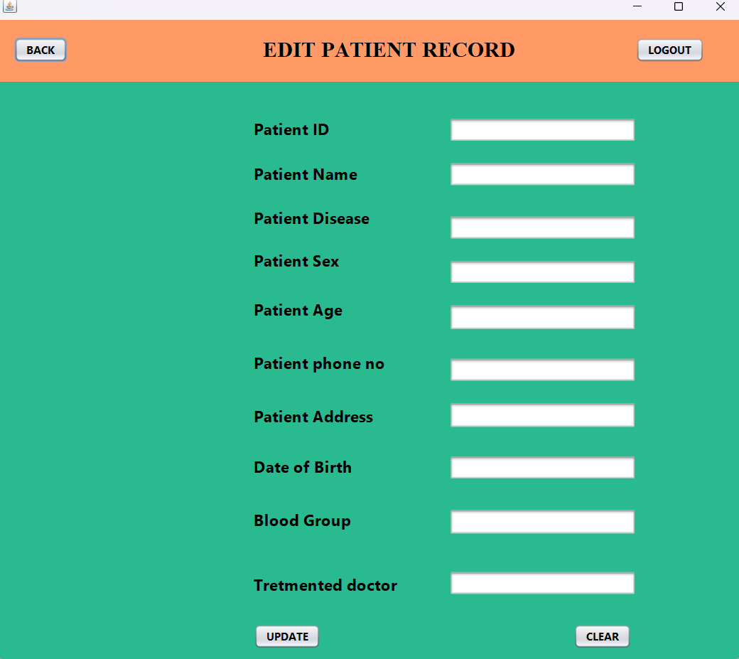
PATIENT RECORDS TEST
INPUTS
OUTPUTS

Slide 12
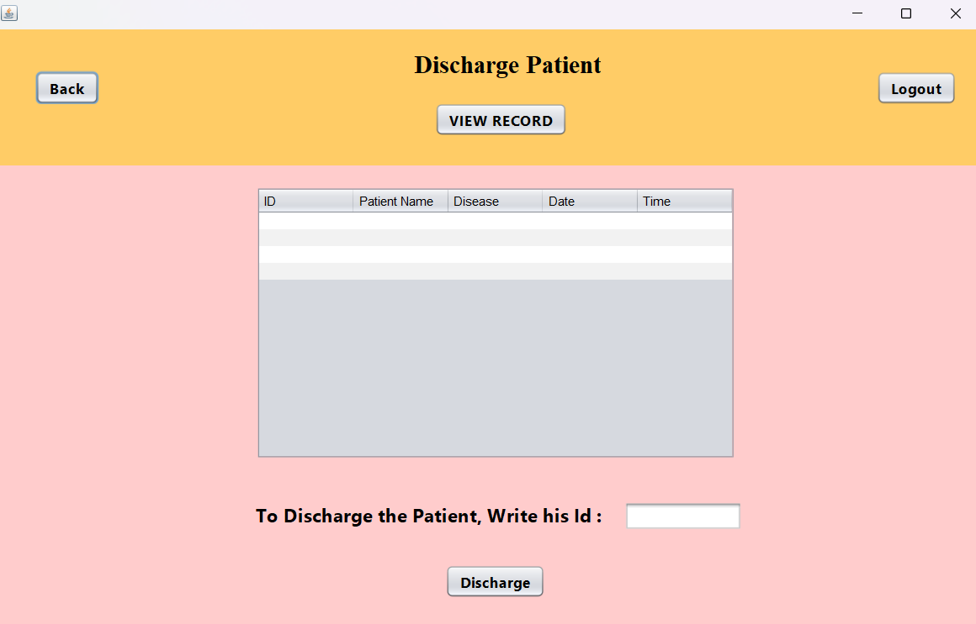
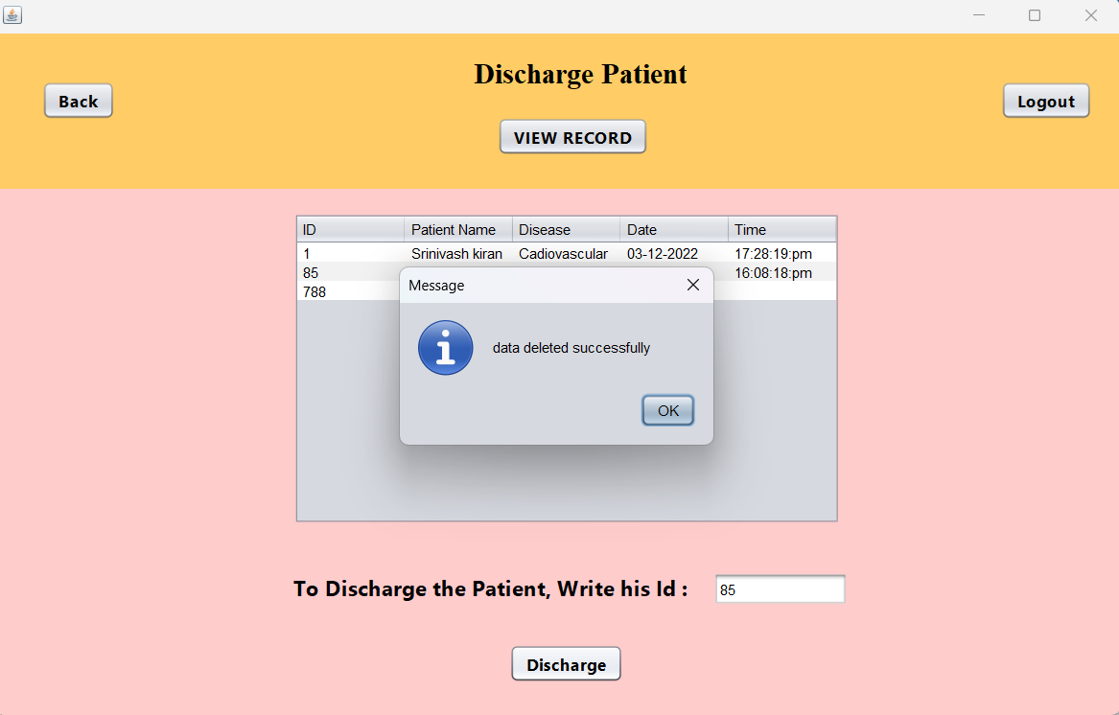
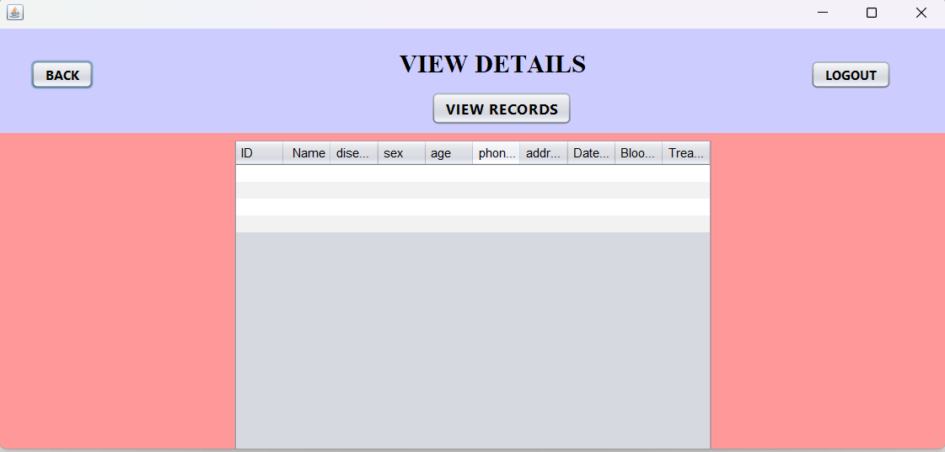
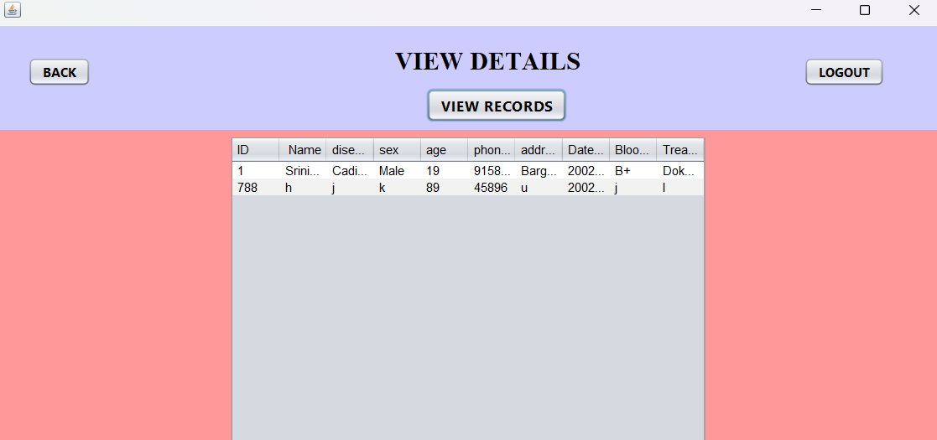
PATIENT RECORDS TEST
INPUTS
OUTPUTS

Slide 13
Conclusion
Implementation of hospital management system project helps to store all the kinds records, provide coordination and user communication, improve day to day Operation and human resources, and market hospital services well-tuned hospital management system involves lots of important decisions that should be made in the most efficient and quick way. Nowadays it is hard to implement it without the distinct hospital management system. In this article, we will explore what is HMS software, what functions it performs and how it helps the healthcare industry be more effective and patient centric.
Hospital management system in the 21st century is necessary. Hospitals are discovering that for effectiveness and efficiency there is a need to adopt cost-effective HIS that can meet organization’s needs.

Slide 14


